Slide 1


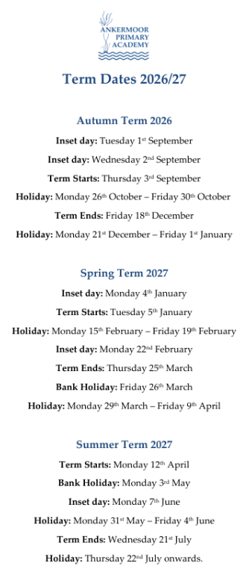


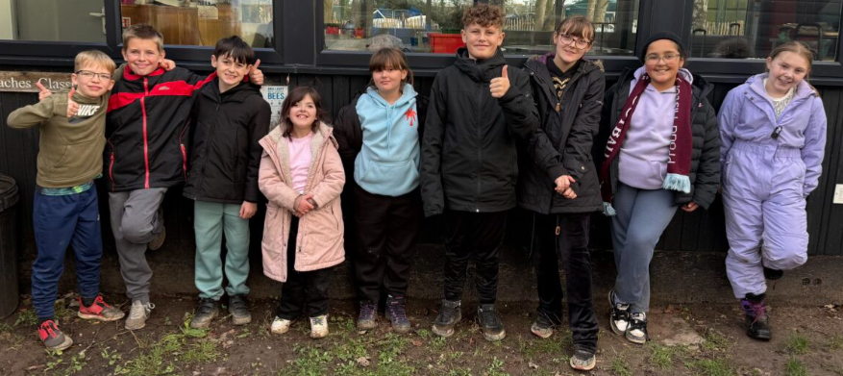

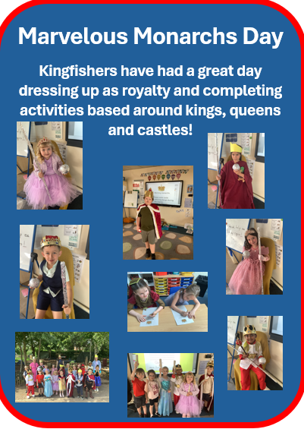
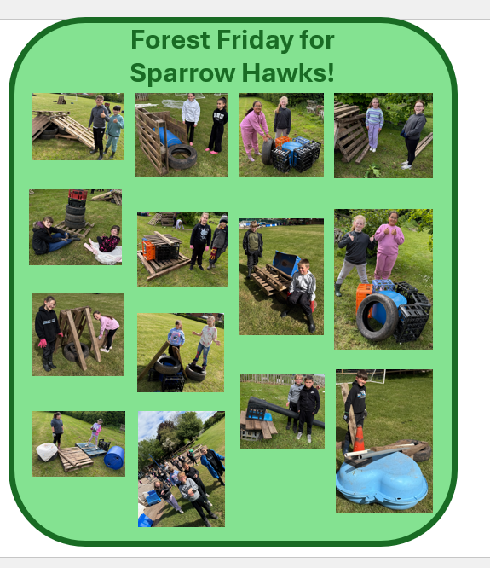

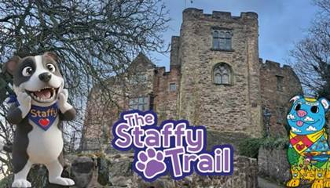
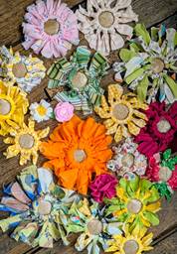

X(Twitter) – @ankermoorfierte
Facebook – Ankermoor Fierte
22nd May 2026
Be Ready, Be Respectful, Be Responsible
A Few Words from Mr Hancox
I would like to say a huge well done to our wonderful Year 6 children, who have approached their SATs this week with such maturity and resilience. We are incredibly proud of the positive attitudes they have shown, arriving each day calm, focused and ready to do their very best. They have demonstrated not only their academic learning, but also the confidence and perseverance that will serve them well next year. A special thank you must also go to our dedicated staff and to parents and carers for their continued support and encouragement throughout this important time. Now that SATs are complete, we are very much looking forward to an exciting final half-term together, filled with opportunities to celebrate, create lasting memories and prepare our Year 6 children for a
smooth and successful
transition to secondary school.
Year 6, you have truly made us
proud!
Please note - The Summer Disco has changed from
the 25th June to the 2nd July.
What has been happening!
Safeguarding - Operation Encompass
We have been asked to periodically remind parents that Ankermoor Primary is part of a scheme called Operation Encompass. This is an agreement with Staffordshire Police that participating schools are notified each time there is a child present when police are called for a domestic abuse incident.
The notification goes to the DSL (Designated Safeguarding Lead – Mr Hancox) who is then able to check the welfare of that child/children in school. The DSL must have carried out Operation Encompass training in order for the school to be included in the project.
It is important to understand that no further details of any incident are included, including the identity of the adults involved and the nature of the incident. The child or children are not questioned about it but may have a quiet welfare check-in by an adult to see that they are settled and okay. The information is kept confidential by the DSL but staff working closely with a child may be asked to look out for and monitor their welfare.
Half Term Activities
Free new Staffy Trail
#FollowStaffy along the Staffy Trail in Tamworth
Explore Tamworth town centre and visit 3 amazing Staffy sculptures along the way. Download the Staffy Trail App to unlock discounts and prizes or pick up a printed map from Tamworth library (or any Staffordshire library).
It takes about 1-1½ hours to walk and is accessible for people with most abilities.
More info: The Staffy Trail - Tamworth –
Free May half-term Flower Making Workshops
Residents, families, schools and community groups are invited to take
part in an exciting and creative project this summer to transform
Tamworth Castle into a breathtaking ‘Flower Castle.’ As part of the Tamworth Flower Festival, taking place from 23 to 26 July, the exterior
of Tamworth Castle will be decorated with hundreds of handmade
fabric, knitted and crocheted flowers, all created by the local community. Join us at the Castle Stables at Holloway, for a free drop-in workshop.
Workshop Dates:
Thursday 28 May, 10:30am–2:00pm – Debbie Murphy
Friday 29 May, 10:30am–2:00pm – Sarah Baxter
Saturday 30 May, 10:30am–2:00pm – Debbie Murphy
* Free, drop-in (no booking required – first come, first served)
* Suitable for children (6+), adults and families
* Children must be supervised by a responsible adult
* A range of simple flower-making techniques available
* All flowers made will be kept by the castle and included in the installation
Location: Castle Stables (near the Castle car park, B79 7ND)
Energy Saving Poster Competition
Fierté Trust Student Council launched a poster competition for their campaign to help save energy in schools and homes across Fierté. This is something we would like children to have a go at in their own time at home.
It should be on A4 paper or card.
Your own choice of media - coloured pencil/felt tip/paint etc.
closing date is Wednesday 3rd June.
The best entries from each year group in the 10 Fierté schools will be judged by the Trust Student Council on 4th June. The overall winners will be copied and displayed across the 10 schools to encourage energy conservation.
Posters might include a catchy title, logos and images to encourage practical ways of saving energy, such as switching off lights, closing doors and windows in cold weather, turning down heating, walking to school etc.
So, get those creative juices flowing and let's see if we can have an Ankermoor winner!
K-Pop Fever
Wednesday 27th May 2026
Bringing the unstoppable energy, dazzling choreography, and iconic style of the world’s biggest music phenomenon, this spectacular tribute show celebrates the global K-pop explosion like never before.
Featuring live vocals and high-energy performances, the show takes you on a non-stop journey through the greatest hits of your favourite K-pop idols.
Booking link: Book an Event | assemblyrooms

Slide 2





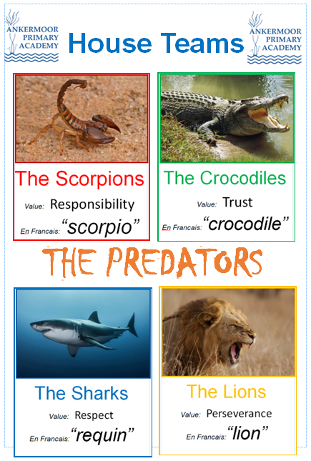
BIKES
We’ve seen an increasing number of children coming to school on bikes, scooters and skateboards independently, which is wonderful to see. However, we have noticed that some children are riding without helmets and are cycling/scooting/skating up and down the roads while waiting to come into school. Please could we ask you to speak with your child about staying safe on their journey to and from school, including wearing a helmet and waiting sensibly near the gates. We really appreciate your support in helping to keep all of our children safe.
Safeguarding - Monitoring Software
Another aspect of our safeguarding armoury in school that we would like to remind parents of, is our monitoring software called SENSO. This software monitors every keystroke and image that appears on the screens of Fierté devices for staff and children. Any letter combinations are checked against an extensive and regularly updated library of terms that may cause concern. This can range from simple swear words to abbreviations and acronyms added by cyber police from their intelligence gathering. It also includes mental health triggers such as someone
saying they are 'fed up' or similar.
Summer 2
Mon 1st June – Year 4 Multiplication tests
Mon 1st June – KS2 Sports club
Tues 2nd June – Year 4 Multiplication tests
Tues 2nd June – KS1 Sports club
Wed 3rd June – Year 4 Multiplication tests
Thurs 4th June – Year 4 Multiplication tests
Thurs 4th June – Year 5/6 Swimming
Fri 5th June – Year 4 Multiplication tests
Any alerts are screenshot and emailed to the DSL to be checked at least weekly. Thankfully, at least 99.9% of the alerts are 'false positives' from typos, letter combinations within words or legitimate use of words such as 'gun' or 'bomb' when researching the Second World War in history. There have been a small handful of times over the years that there have been 'captures' of words that have been written deliberately. These have all been children who have thought it would be clever to write a swear word, then delete it. Unfortunately for them, it records any keystrokes and the username, so they were spoken to and parents informed. This helps children understand that anything they share online can be seen and can have consequences. While this is a useful tool to manage children's behaviour online, the most important reason for using this software is for safeguarding and keeping our children safe.
Mon 8th June – KS1 Phonics Screening tests
Mon 8th June – KS2 Sports club
Tues 9th June – KS1 Phonics Screening tests
Tues 9th June – KS1 Sports club
Wed 10th June – KS1 Phonics Screening tests
Thurs 11th June – KS1 Phonics Screening tests
Thurs 11th June – Year 5/6 Swimming
Thurs 11th June – Class Photos
Fri 12th June – KS1 Phonics Screening tests
Fri 12th June – Parent Lunch Year 5/6
Fri 12th June - Forest Friday/Nursery
SUMMER FAIR STALL HOLDERS WANTED! We are excited to announce our upcoming Summer Fair on Friday 10th July 2026 and are looking for a variety of stall holders to join us for a fun-filled day!
Do you have a small business, craft, or products to sell? We'd love to hear from you!
Please send us your name and contact details and a brief description of what you would like to sell to office@ankermoor.org – we look forward to hearing from you!
Mon 15th June – KS2 Sports club
Tues 16th June – Athletics competition (small schools)
Thurs 18th June – Year 5/6 Swimming
Fri 19th June – Parent Lunch Year 3/4
Fri 19th June - Forest Friday Year ½
Mon 22nd June – KS2 Sports club
Mon 22nd June - Father’s Day – Sports and cake
Tues 23rd June– KS1 Sports club
Tues 23rd June - Sports Day
Thurs 25th June – Year 5/6 Swimming
Fri 26th June – Parent Lunch Year 1/2
Fri 26th June - Forest Friday Year 3/4
Mon 29th June - Fierte Festival week
Mon 29th June – KS2 Sports club
Tues 30th June - Fierte Festival week
Tues 30th June – KS1 Sports club
Wed 1st July - Fierte Festival week
Thurs 2nd July - Fierte Festival week
Thurs 2nd July – Year 5/6 Swimming
Thurs 2nd July - Summer Disco
Fri 3rd July - Fierte Festival week
Fri 3rd July – Parent Lunch Reception
Sat 4th July – Showcase Day (Fierte Festival) – Tamworth Castle Grounds
Mon 6th July – KS2 Sports club
Mon 6th July - chocolate/alcohol/toys – non school uniform (donations for Summer Fair
Tues 7th July– KS1 Sports club
Thurs 9th July – Year 5/6 Swimming
Thurs 9th July - Reception (New to school transition)
Fri 10th July – Summer Fair (3.30pm – 5pm)
Fri 10th July - Forest Friday Year 5/6
Tues 14th July – Rock Steady Concert
Thurs 16th July – Year 5/6 Swimming
Thurs 16th July - Summer finale menu
Fri 17th July – Year 6 final assembly
Fri 17th July – Break up for Summer
House Points
Value Champions
Attendance
for the year
3299
Robins/Owls
Kingfishers
Kestrels
Sparrow Hawks
Lily E-C
Harper J
Juan A
All of Year 6
15th May
Owls/Robins (Reception) 92.8%
Kingfishers (Year 1/2) 93.8%
Kestrels (Year 3/4) 93.2%
Sparrow Hawks (Year 5/6) 94.2%
3267
22nd May
3221
Robins/Owls
Kingfishers
Kestrels
Sparrow Hawks
Lottie M
Auben A/Dolton C
Ava D
Charlotte e
3234

Slide 3


Slide 4


