Slide 1



A message from us here
At Ankermoor Academy
#Team Ankermoor

Slide 2
Our world has been turned
upside down.

Slide 3
Everyone here at Ankermoor
wants to share some messages.

Slide 4


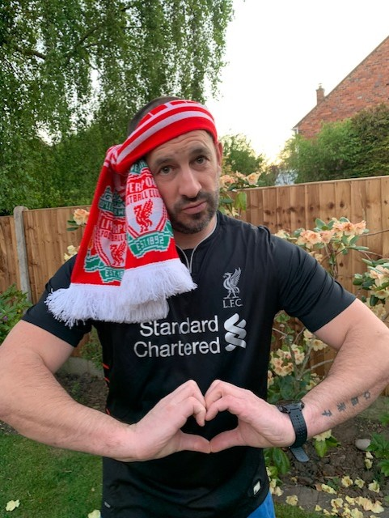

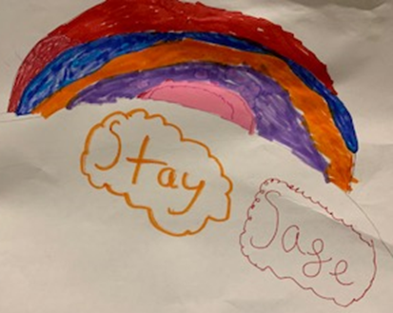
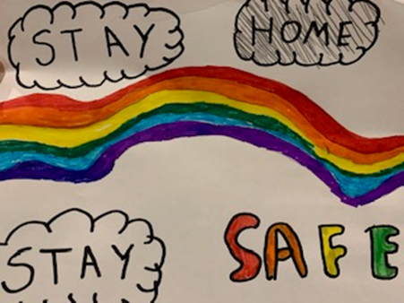
Mr Russell

Slide 5
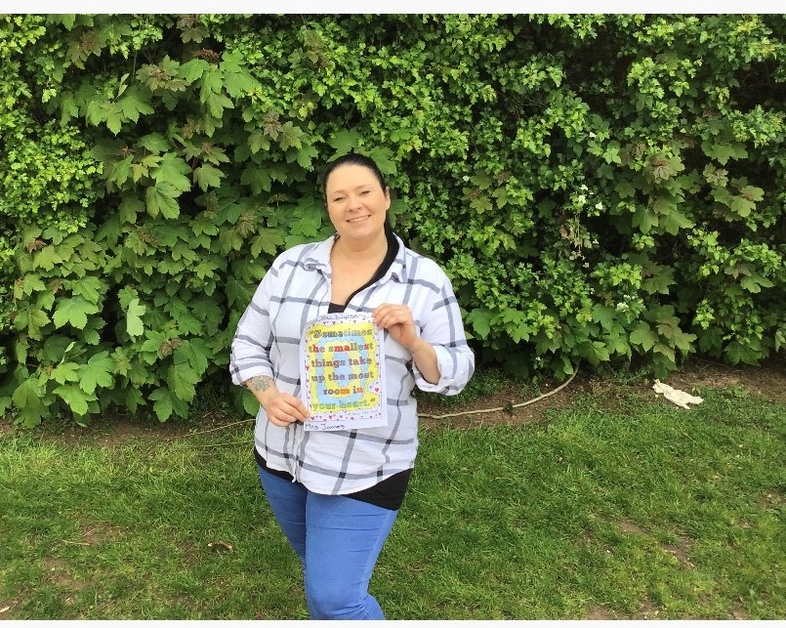
Mrs James

Slide 6
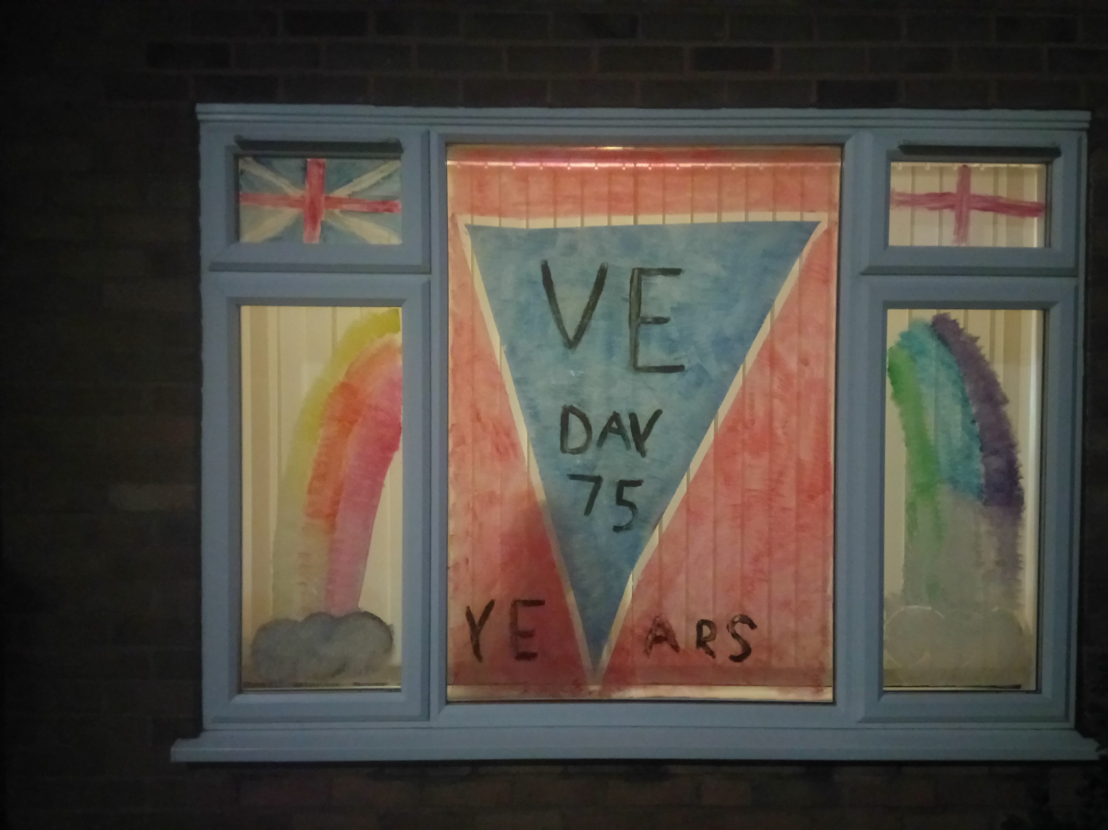
Miss Hopkins

Slide 7
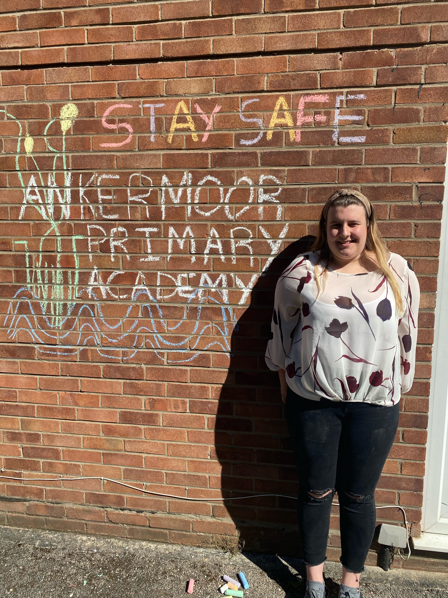
Miss Taft

Slide 8
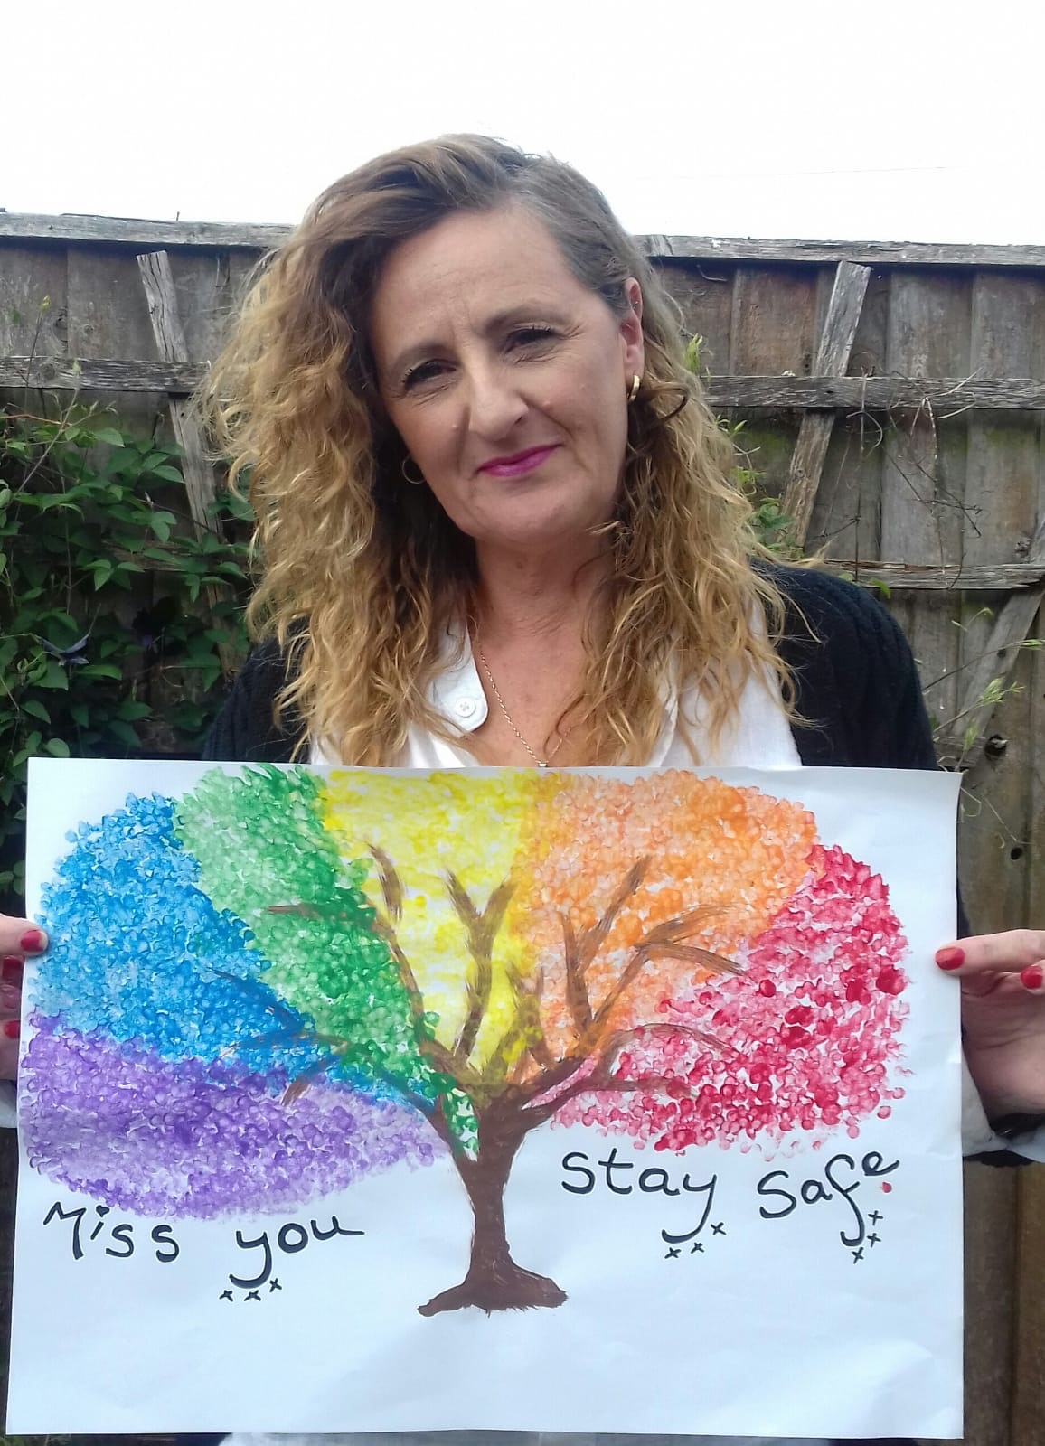
Mrs Boag

Slide 9
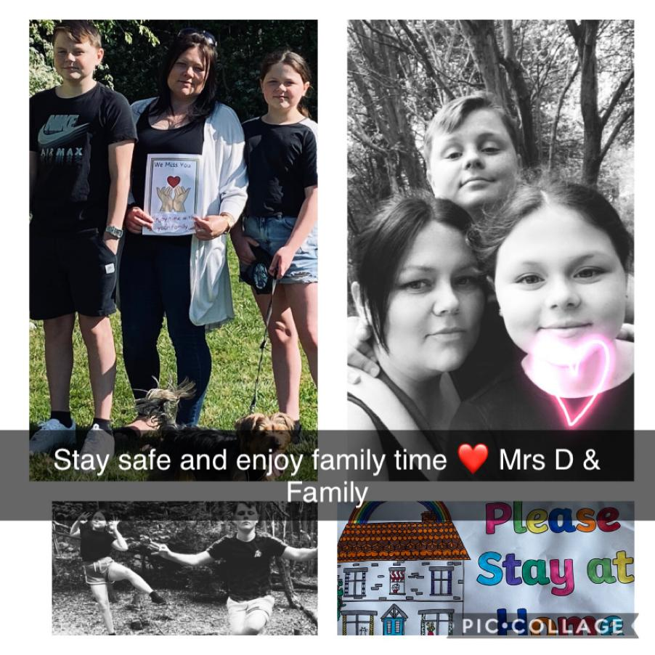
Mrs Davies

Slide 10
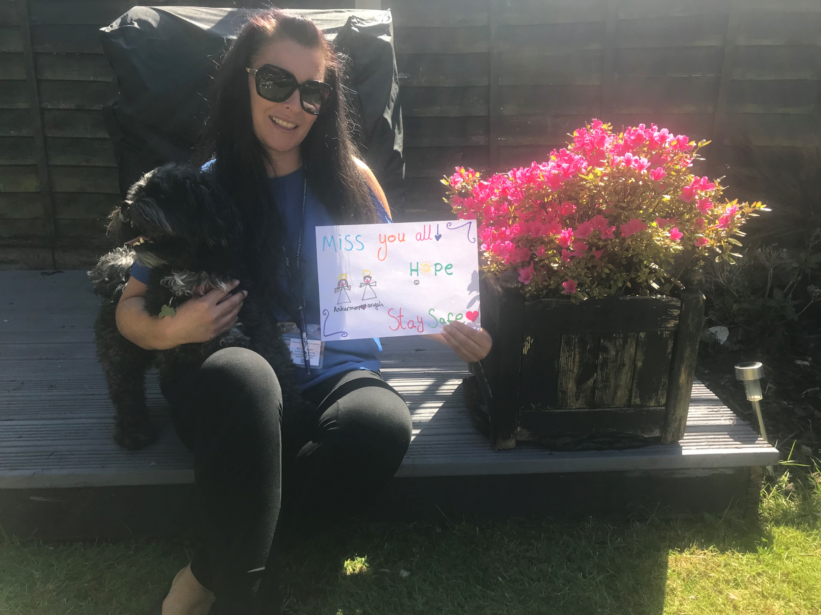
Mrs Bryan

Slide 11
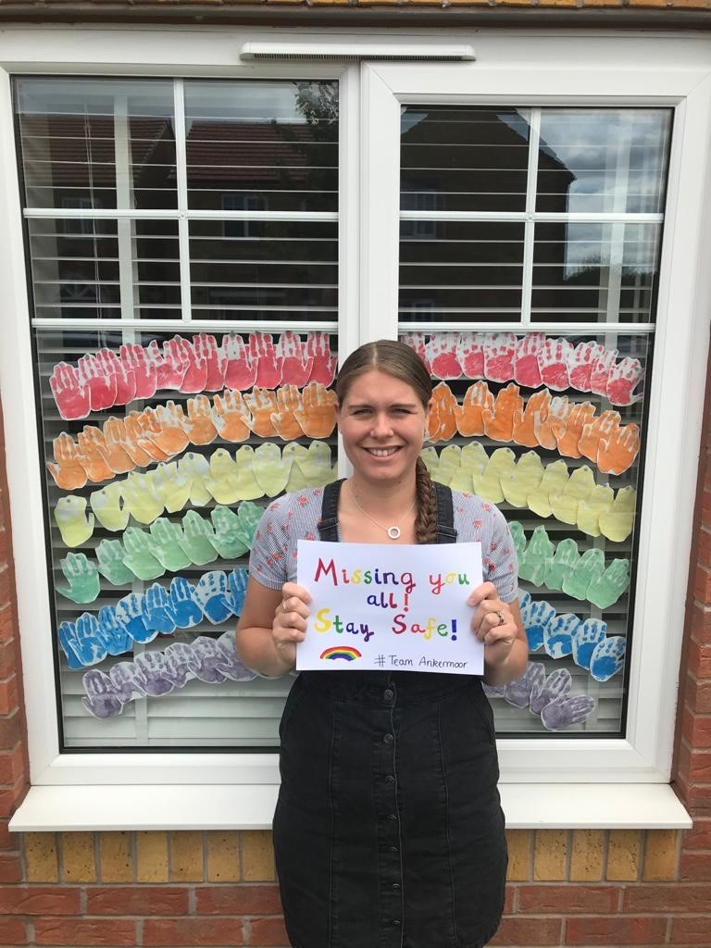
Mrs Walton

Slide 12
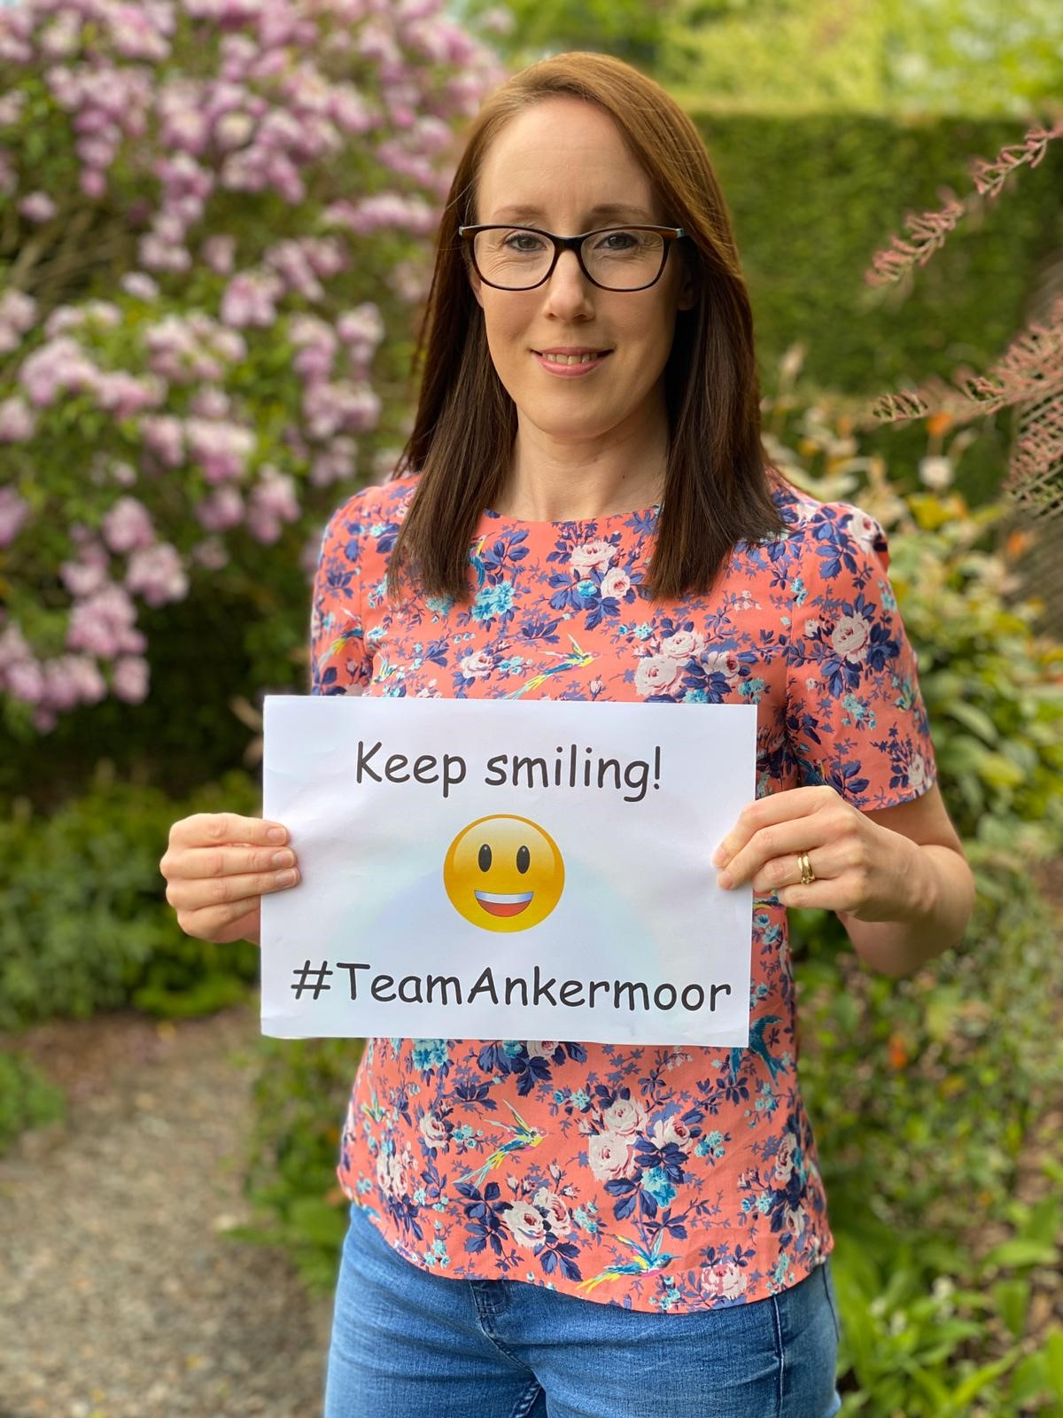
Mrs Foster

Slide 13
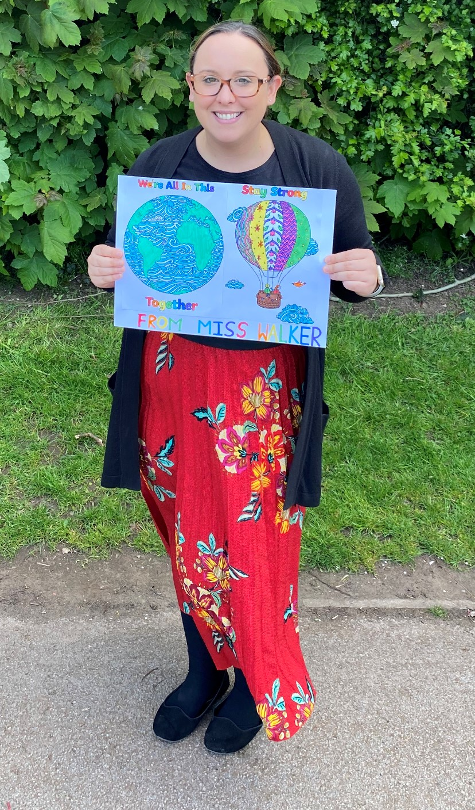
Miss Walker

Slide 14
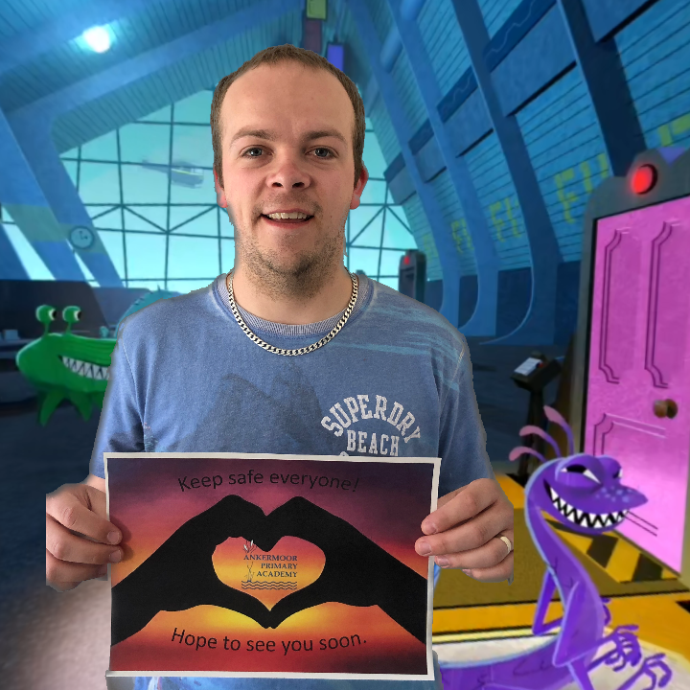
Mr Macdonald

Slide 15
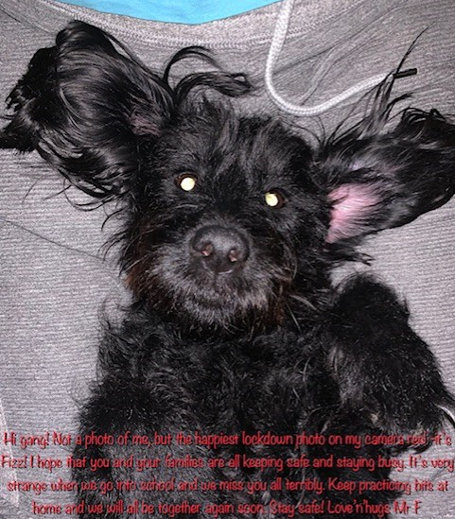
Mr Fitzpatrick

Slide 16
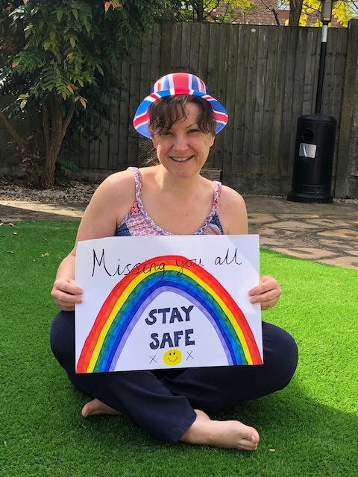
Mrs Barnes

Slide 17
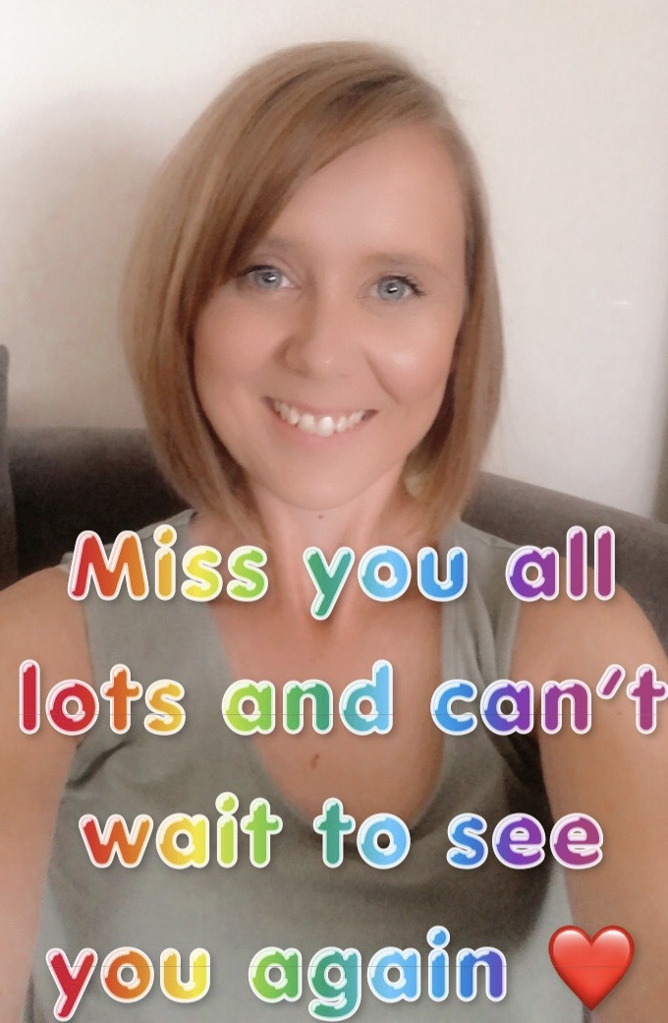
Mrs Porter

Slide 18
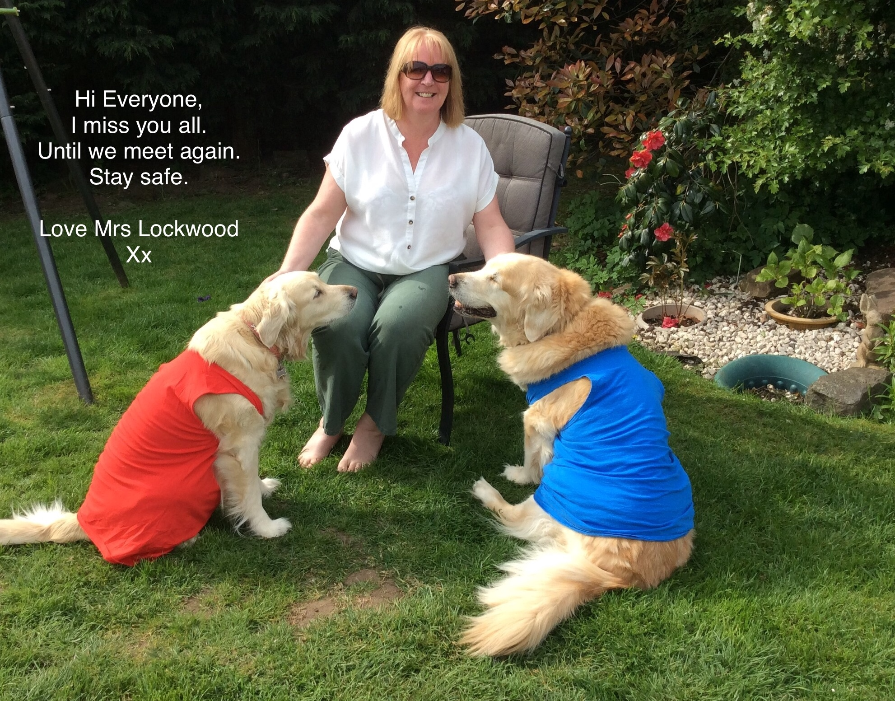
Mrs Lockwood

Slide 19
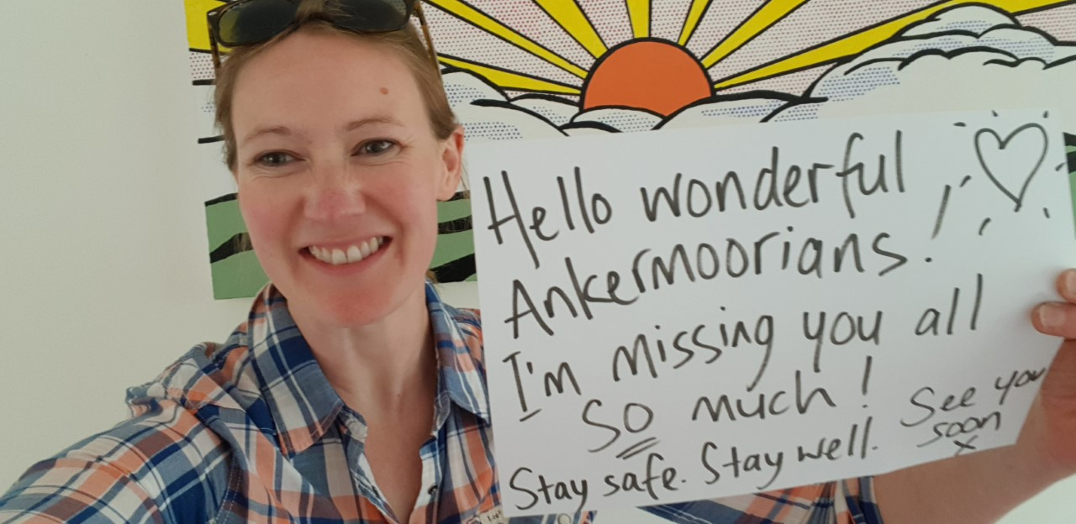
Mrs Walk

Slide 20
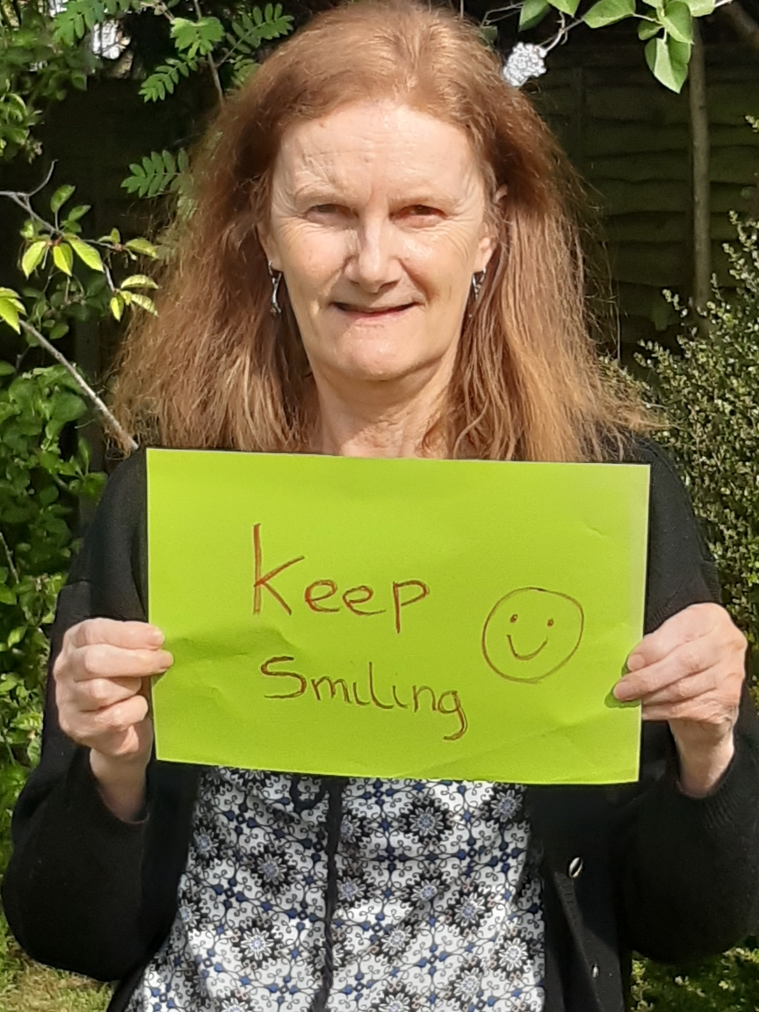
Mrs Hedderman

Slide 21
It’s safe to say, everyone
here at Ankermoor is missing
you all greatly.
Please keep safe and we will
see you all soon.

Slide 22










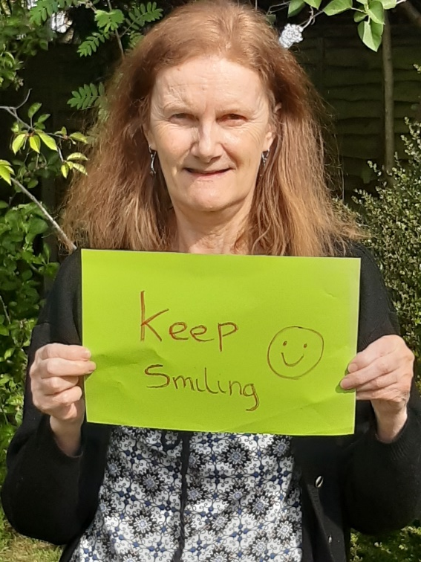
#TeamAnkermoor

